Slide 1

Topic for the class: Faraday’s law & DC Generator. Unit: III Title : Electrical Machines. Date: 09-05-2022 Time: 03:00PM
Mr. Pradeep Vinaik Kodavanti
Assistant Professor
Department of EECE
GITAM Institute of Technology (GIT)
Visakhapatnam – 530045
Email: pkodavan@gitam.edu

Slide 2

Course Objectives
To impart the analysis & design aspects of DC networks in electrical & electronic circuits.
To explain the basic concepts of AC networks used in electrical & electronic circuits.
To demonstrate the importance and operating principles of electrical machines. (transformers, motors and generators)
To impart the knowledge about the characteristics, working principles & applications of semiconductor diodes, MOSFETs.
To expose basic concepts & applications of OpAmp configurations.

Slide 3
Learning Outcomes
After completion of this unit, the student will be able to
Understand working principle of dc machines (L1).
Demonstrate principle operation of transformer (L3).
Discuss about open and short- circuit tests of transformer (L2).
Explain the working principle of three phase induction motor (L5).
Gain knowledge on applications as special machines, stepper motor (L1).
Identify and choose servo motor and BLDC motor applications (L2).

Slide 4
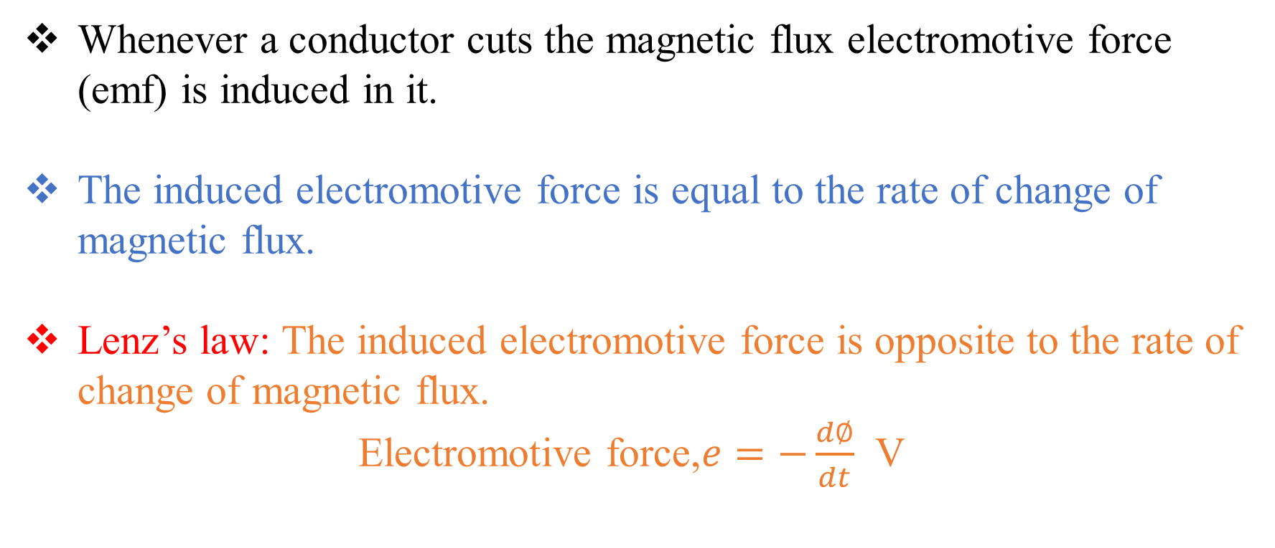
Faraday’s laws of electromagnetic induction
Whenever a conductor cuts the magnetic flux electromotive force (emf) is induced in it.
The induced electromotive force is equal to the rate of change of magnetic flux.
Lenz’s law: The induced electromotive force is opposite to the rate of change of magnetic flux.
Electromotive force,$e=−\frac{d∅}{dt}$ V

Slide 5
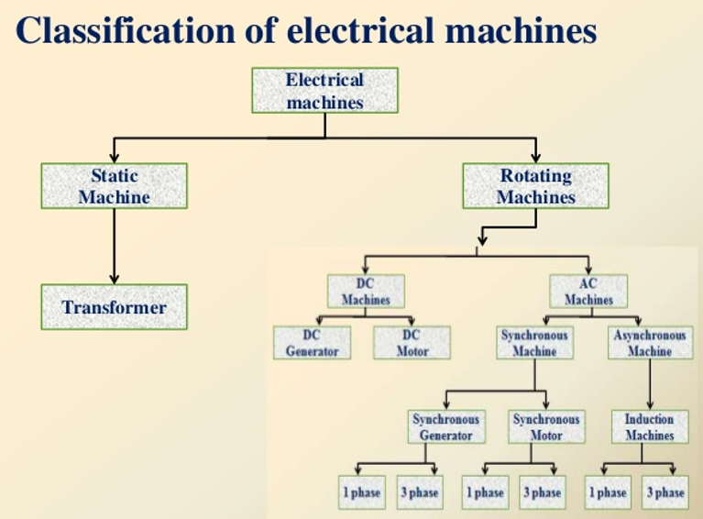

Slide 6
DC Generator
An electrical Generator is a machine which converts mechanical energy (or power) into electrical energy (or power).
DC Generator
Mechanical input
Electrical output

Slide 7
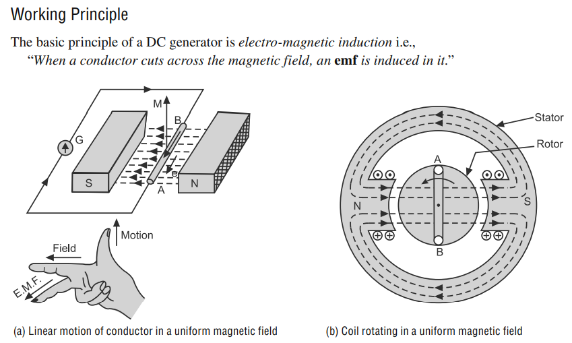
DC Generator

Slide 8
DC Generator
An electrical Generator is a machine which converts mechanical energy (or power) into electrical energy (or power).
The energy conversion is based on the principle of production of dynamically (or motionally) induced e.m.f.
Whenever a conductor cuts magnetic flux, dynamically induced e.m.f. is produced in it. (Faraday’s laws of electromagnetic induction)
This e.m.f. causes a current to flow if the conductor circuit is closed.
Essential parts of generator -> Magnetic flux
-> Conductor to cut the flux

Slide 9
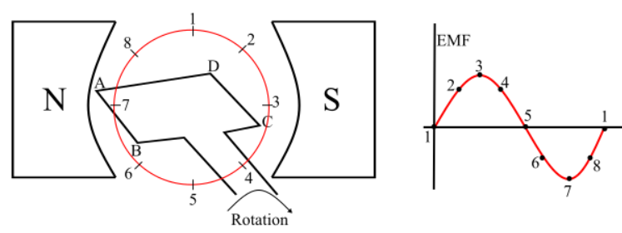
Working of a DC Generator
Consider a single loop DC generator, a single turn loop ‘ABCD’ is rotating clockwise in a uniform magnetic field with a constant speed.
When the loop rotates, the magnetic flux linking the coil sides ‘AB’ and ‘CD’ changes continuously.
This change in flux linkage induces an EMF in coil sides and the induced EMF in one coil side adds the induced EMF in the other.

Slide 10
Working of a DC Generator
Loop in position 1-> the generated EMF is zero because, the movement of coil sides is parallel to the magnetic flux.
Loop in position 2-> the coil sides are moving at an angle to the magnetic flux and hence, a small EMF is generated.
Loop in position 3-> the coil sides are moving at right angle to the magnetic flux, therefore the generated EMF is maximum.

Slide 11
Working of a DC Generator
Loop in position 4-> the coil sides are cutting the magnetic flux at an angle, thus a reduced EMF is generated in the coil sides.
Loop in position 5-> no flux linkage with the coil side and are moving parallel to the magnetic flux. Therefore, no EMF is generated in the coil.
Loop in position 6-> the coil sides move under a pole of opposite polarity and hence the polarity of generated EMF is reversed.

Slide 12
Working of a DC Generator
The maximum EMF will generate in this direction at position-7 and zero when at position-1.
This cycle repeats with revolution of the coil.

Slide 13
Working of a DC Generator
The generated EMF in the loop is alternating one.
It is because any coil side (say AB) has EMF in one direction when under the influence of N-pole and in the other direction when under the influence of S-pole.
Hence, when a load is connected across the terminals of the generator, an alternating current will flow through it.
By using a commutator, this alternating emf generated in the loop can be converted into direct voltage.

Slide 14
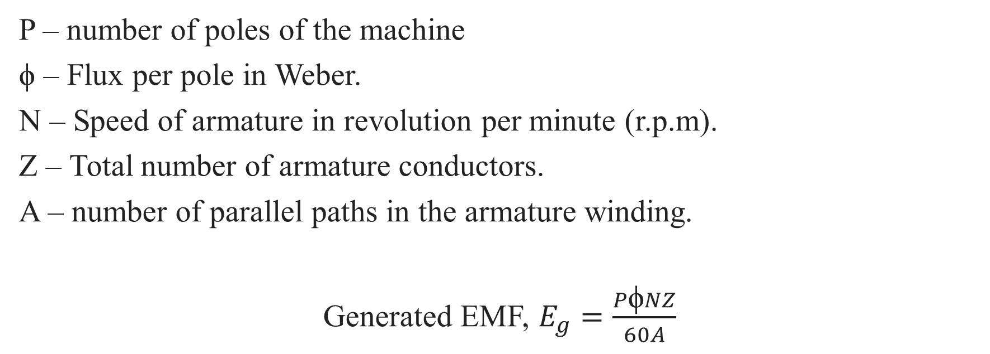
EMF equation of a DC Generator
P – number of poles of the machine
ϕ – Flux per pole in Weber.
N – Speed of armature in revolution per minute (r.p.m).
Z – Total number of armature conductors.
A – number of parallel paths in the armature winding.
Generated EMF, $E_{g}=\frac{P\text{ϕ}NZ}{60A}$

Slide 15
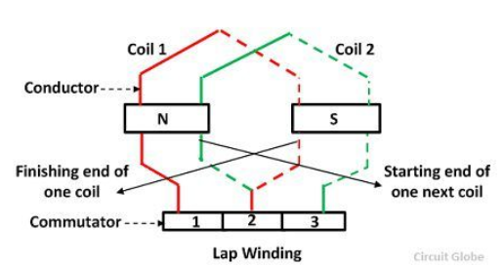
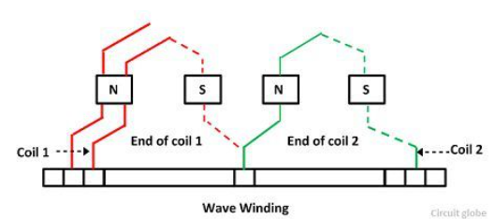
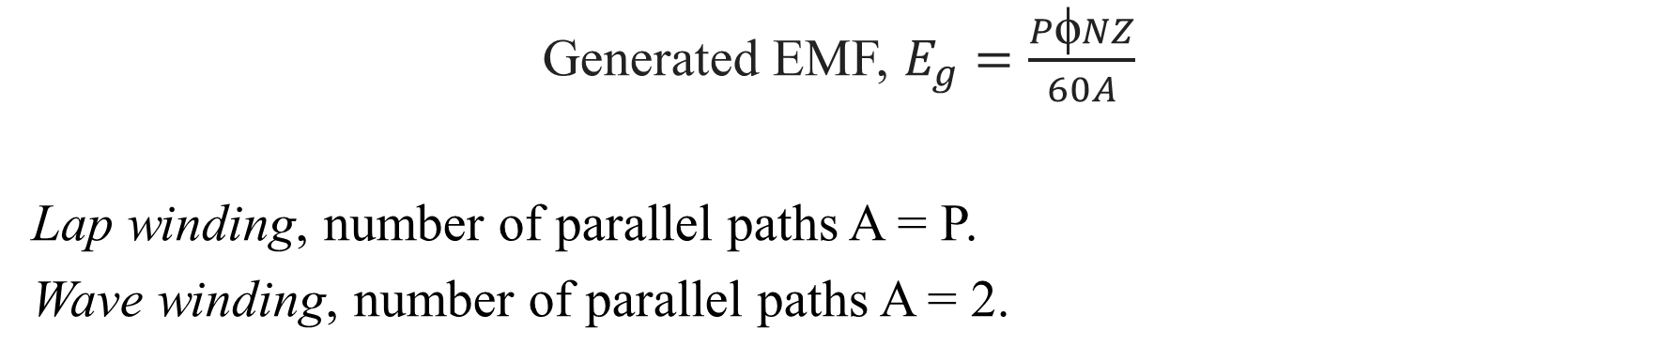
EMF equation of a DC Generator
Generated EMF, $E_{g}=\frac{P\text{ϕ}NZ}{60A}$
Lap winding, number of parallel paths A = P.
Wave winding, number of parallel paths A = 2.

Slide 16
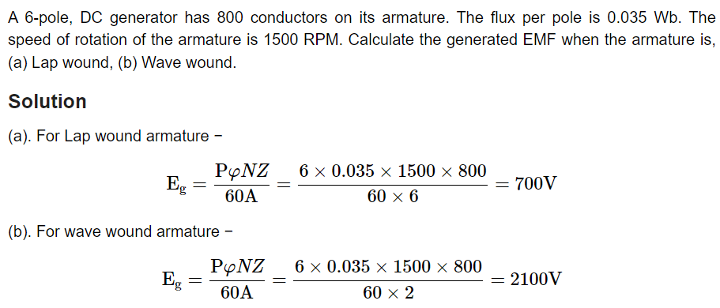
EMF equation of a DC Generator

Slide 17
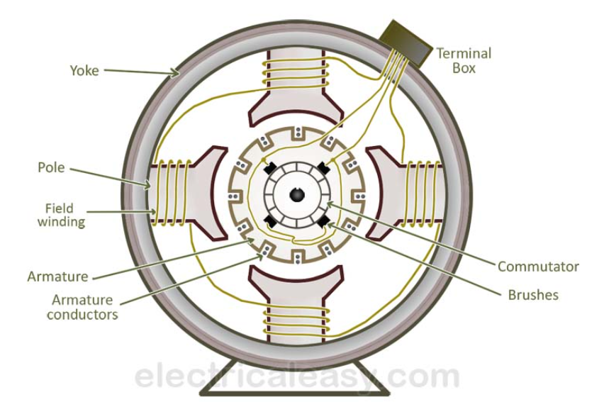
Construction of a DC Generator

Slide 18
1. Magnetic Frame or Yoke
The outer cylindrical frame to which main poles and inter poles are fixed is called yoke. It also helps to fix the machine on the foundation. It serves two purposes:
1. It provides mechanical protection to the inner parts of the machine.
2. It provides a low reluctance path for
the magnetic flux.
The yoke is made of cast iron for smaller
machines and for larger machines, it is
made of cast steel or fabricated rolled.

Slide 19
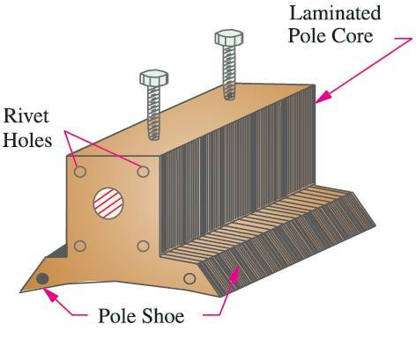
2. Pole Core and Pole Shoes
The pole core & pole shoes are fixed to the magnetic frame or yoke by bolts. They serve the following purposes:
1. They support the field or exciting coils.
2. They spread out the magnetic flux over the armature periphery more
uniformly.
3. Since pole shoes have larger X-section,
the reluctance of magnetic path is reduced.
The pole core and pole shoes are made of
thin cast steel or wrought iron laminations.

Slide 20
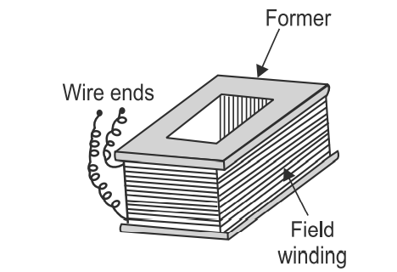
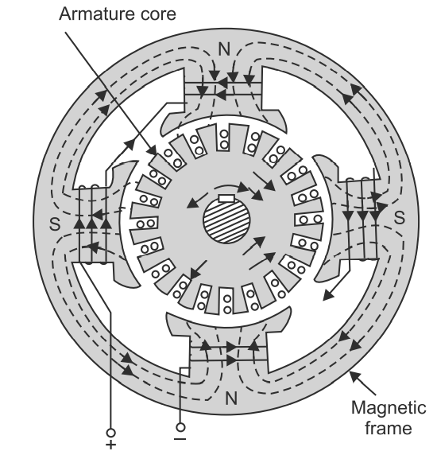
3. Field or Exciting Coils
Enamelled copper wire is used for construction of field or exciting coils.
Coils are wound on the former & then placed around the pole core.
When direct current is passed through the field winding, it magnetizes the poles which produce the required flux.
The field coils of all the poles are connected in series in such a way that when current flows through them, the adjacent poles attain opposite polarity.

Slide 21
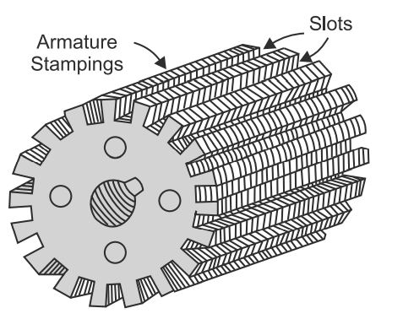
4. Armature Core
It is cylindrical is shape and keyed to the rotating shaft. At the outer periphery slots are cut, which accommodate the armature winding.
The armature core shown, serves the following purposes:
1. It houses the conductors in the slots.
2. It provides an easy path for magnetic flux.
Armature is a rotating part of the machine, reversal of flux takes place in the core, hence hysteresis losses are produced. To minimize these losses silicon steel material is used for its construction.
To reduce eddy current losses, armature core is laminated.

Slide 22
5. Armature Winding
The insulated conductors housed in the armature slots are suitably connected. This is known as armature winding.
Two types of armature windings
Lap winding and
Wave winding

Slide 23
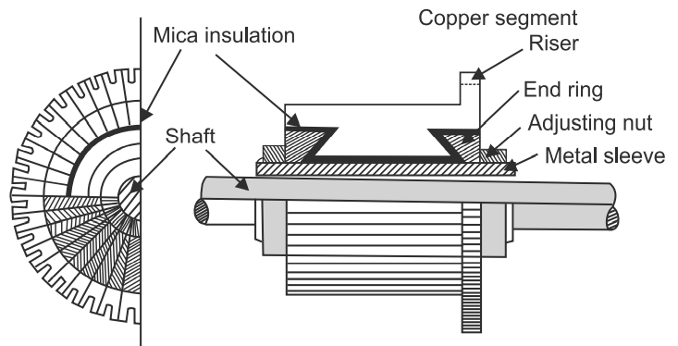
6. Commutator
It is an important part of a DC machine and serves the purposes:
1. It connects the rotating armature conductors to the stationary external circuit through brushes.
2. It converts the alternating current induced in the armature conductors into unidirectional current in the external load circuit in generator action, whereas, it converts the alternating torque into unidirectional (continuous) torque produced in the armature in motor action.

Slide 24
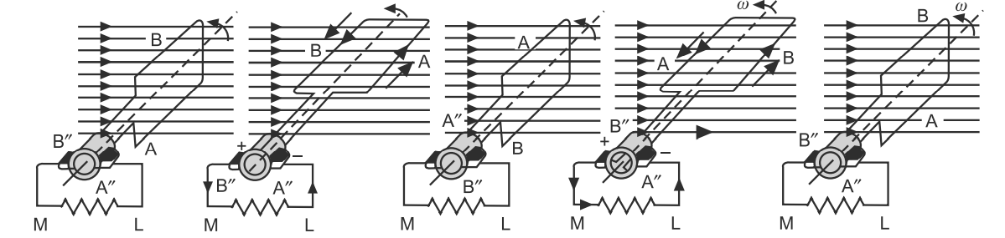
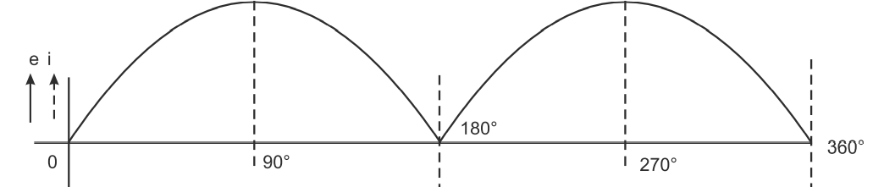
6. Commutator action
An alternating current is converted into unidirectional current in the external circuit with the help of a split ring.

Slide 25
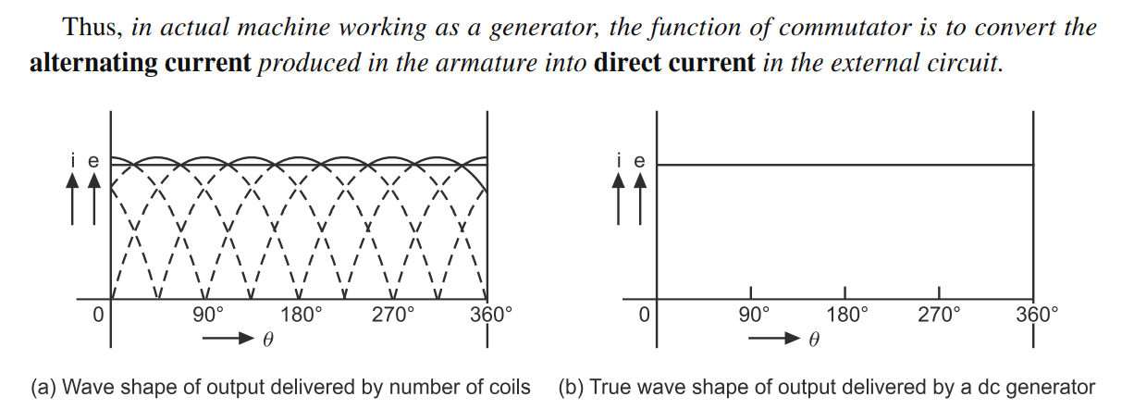
6. Commutator action contd…

Slide 26
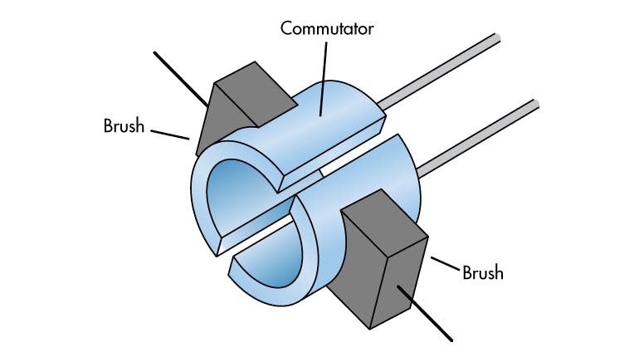
7. Brushes
The brushes are pressed upon the commutator and form the connecting link between the armature winding and the external circuit.
They are usually made of high grade carbon because carbon is conducting material and at the same time in powdered form provides lubricating effect on the commutator surface.
The brushes are held in particular position around the commutator by brush holders and rocker.

Slide 27
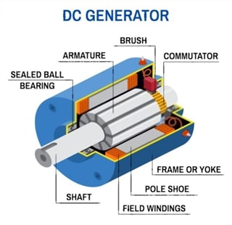
8. Shaft
The shaft is made of mild steel with a maximum breaking strength.
The shaft is used to transfer
mechanical power from or to
the machine.
The rotating parts like
armature core, commutator,
cooling fan etc. are keyed to
the shaft.

Slide 28
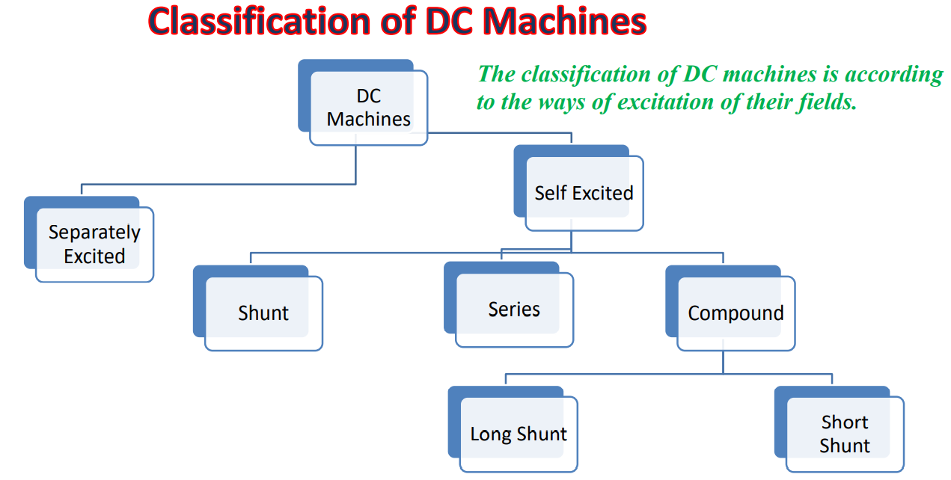

Slide 29
Applications of DC Generator
Depending upon the characteristics of various types of DC generators, their important applications are given below:
Separately excited DC generators: These generators are more costly than self excited generators as they require a separate source for their field excitation. But their response to the change in field resistance is more quick and precise.
Shunt-wound DC generators: As they provide constant terminal voltage, they are best suited for battery charging. Along with field regulators, they are also used for light and power supply purposes.

Slide 30
Applications of DC Generator
3. Series-wound DC generators: Their best application is in the DC
locomotives, where they supply field current for regenerative braking.
They are also employed in series arc lighting.
4. Compound-wound DC generators:
Over-compounded type. These are more suited for lighting and power services, as they compensate for the voltage drop in the lines and voltage at the terminals of the load remains constant.
Differential-compounded type. They are usefully employed as are welding sets. In such cases, generator is practically short-circuited every time the electrode touches the metal plates to be welded.

Slide 31
DC Motor
DC Generator
Mechanical input
Electrical output
DC Motor
Electrical input
Mechanical output

Slide 32
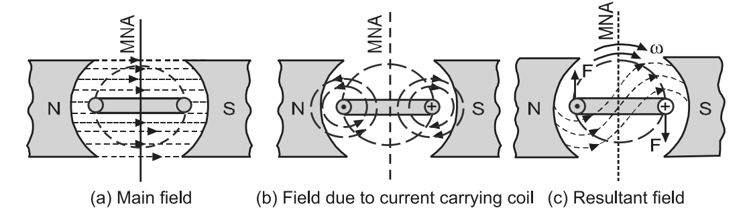
DC Motor
A machine that converts mechanical power into DC electrical power is called a DC generator. The same machine when used to convert DC electrical power into mechanical power, it known as a DC motor.
From construction point of view there is no difference between a DC generator and motor.
The operation of a DC motor is based on the principle that when a current carrying conductor is
placed in a magnetic
field, a mechanical
force is experienced
by it.

Slide 33
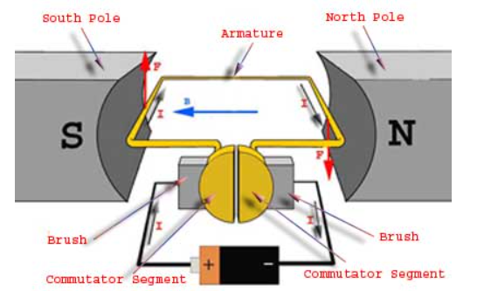
DC Motor
The direction of this force is determined by Fleming’s Left Hand Rule and its magnitude is given by the relation: F = BIL Newton

Slide 34
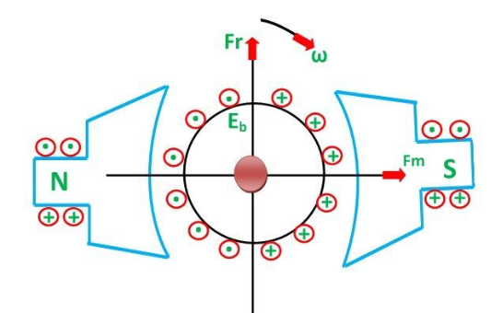
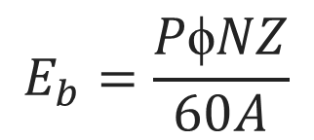
Back EMF
When current is supplied to the armature conductors, placed in the main magnetic field, torque develops and armature rotates.
The armature conductors cut across the magnetic field and an emf is induced in these conductors.
The direction of this induced emf in the armature conductors is determined by Fleming’s Right Hand Rule and it is opposite to the applied voltage.
$$E_{b}=\frac{P\text{ϕ}NZ}{60A}$$

Slide 35
Applications of DC Motors
Lathe machine
Drilling machine
Grinders
Blowers
Compressors
Electric traction
Hoists and lifts
Crane
Rolling mills
conveyors & Elevators

Slide 36
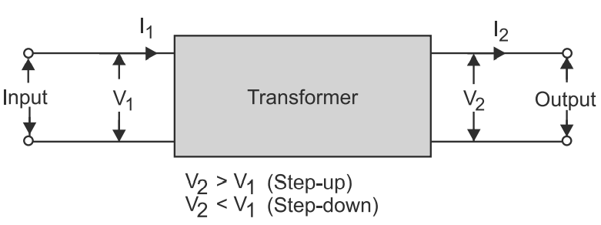
Transformer
Transformer is considered to be a backbone of a power system.
A transformer is a static device that transfers AC electrical power from one circuit to the other at the same frequency but the voltage level is usually changed.

Slide 37
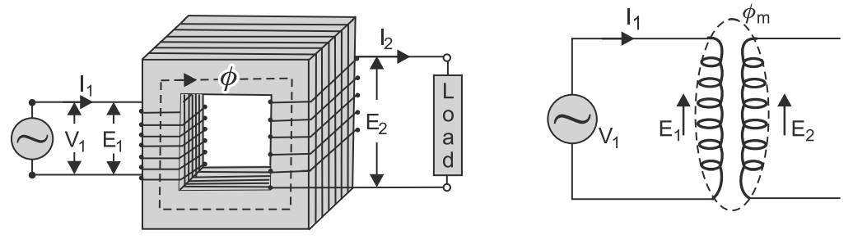
Transformer Working Principle
The basic principle of a transformer is electromagnetic induction.
A single-phase transformer consists of two windings placed over a laminated silicon steel core.
Winding having less number of turns is called low-voltage winding and winding having more number of turns is called high voltage winding.

Slide 38
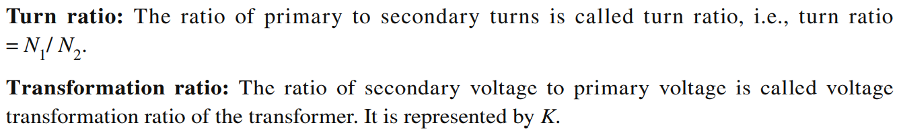

Transformer Working Principle

Slide 39
Construction of Transformer
Magnetic circuit mainly comprises of transformer core having limbs and yokes.
Electric circuits mainly comprises of windings, insulation and bushings.
Tank mainly comprises of cooling devices, conservator and ancillary apparatus.
The construction of a transformer depends largely on its size and the duty which it is to perform.

Slide 40
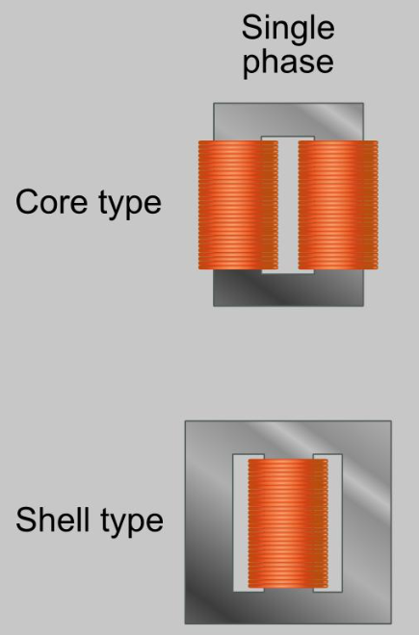
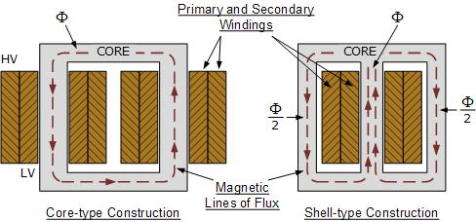
Transformer Core
Core type transformer uses concentric cylindrical winding whereas the shell type transformer uses sandwiched winding.
In a core type transformer, winding surrounds the core whereas, in a shell type transformer, the core surrounds the winding.

Slide 41
Transformer Core Material
Core consists of sheets of alloy steels, the main constituents of alloy steel are silicon and carbon in small quantities which increases the permeability at low flux densities and reduces the hysteresis loss to large extent.
Addition of silicon also reduces the eddy currents to some extent because it increases the resistivity. In addition to this, these constituents also increase the mechanical strength of the core.
Cold rolled grain oriented steel (CRGOS) sheets are used for core construction because of their excellent magnetic properties in the direction of rolling. It allows flux density as high as 2.8 Wb/m2.

Slide 42
Transformer Windings
Transformer windings may be classified into two groups
Concentric winding - used in core type transformers
Sandwiched winding - used in shell type transformers
The low-voltage winding is placed nearer to the core in the case of concentric windings and on the outside positions in the case of sandwiched windings.

Slide 43
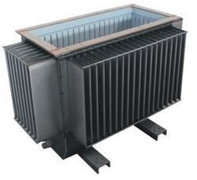
Transformer Tank
Transformer tank also named transformer tank body.
It is used to hold, protect, cool the winding and core in one Electrical distributor transformer.
The tank body provides isolation of oil and the core from the outside environment.

Slide 44
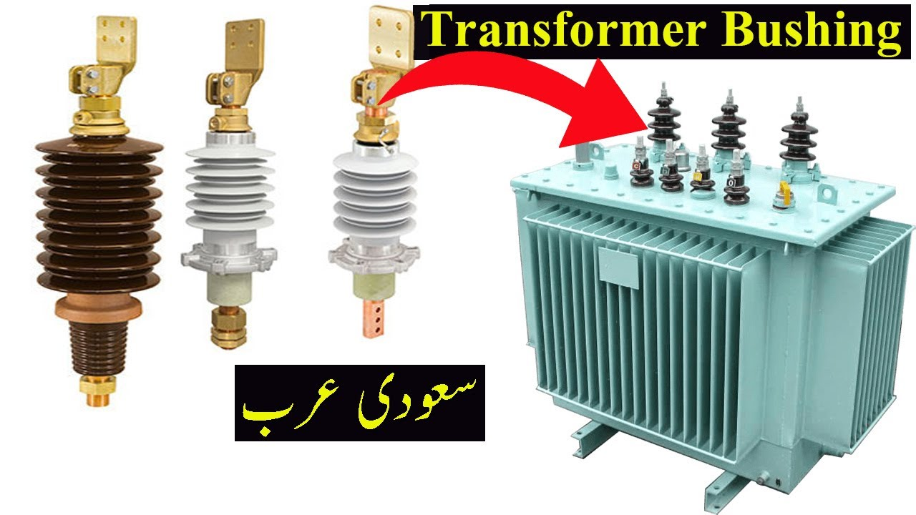
Transformer Bushing
A bushing is an insulated device that allows an electrical conductor to pass safely through an (usually) earthed conducting barrier such as the wall of a transformer.

Slide 45
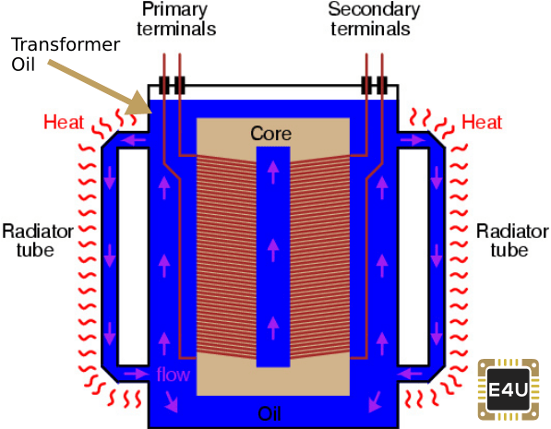
Transformer Oil
The insulating oil provides better insulation, protects insulation from moisture and transfers the heat produced in core and windings to the atmosphere.
Transformer oil is generally a mineral oil obtained by fractional distillation of crude oil.

Slide 46
Applications of Transformer
To change the level of voltage and current in electric power systems.
As impedance-matching device for maximum power transfer in low-power electronic and control circuits.
As a coupling device is electronic circuits.
To isolate one circuit from another, since primary and secondary are not electrically connected.
To measure voltage and currents; these are known as instrument transformers.

Slide 47
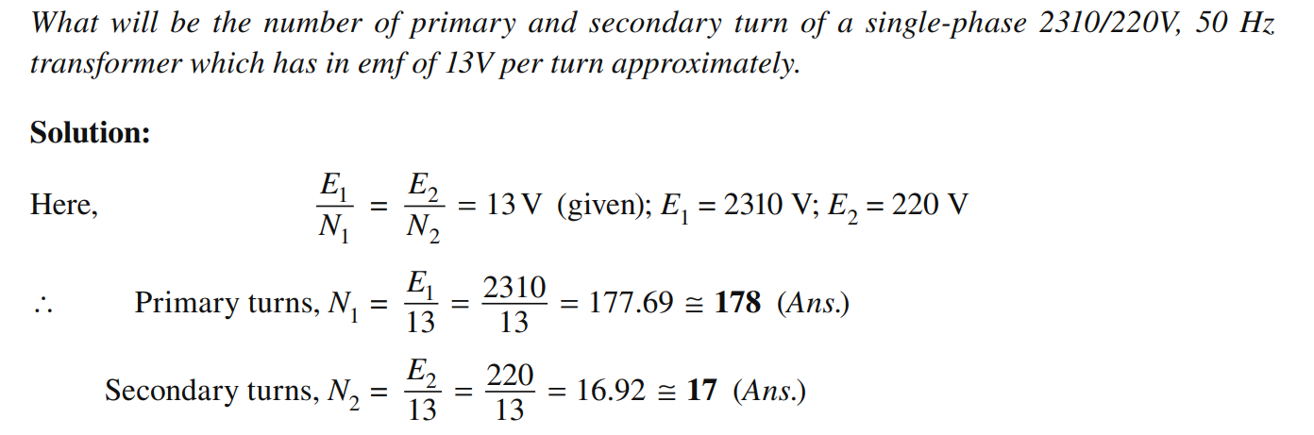
Problem

Slide 48
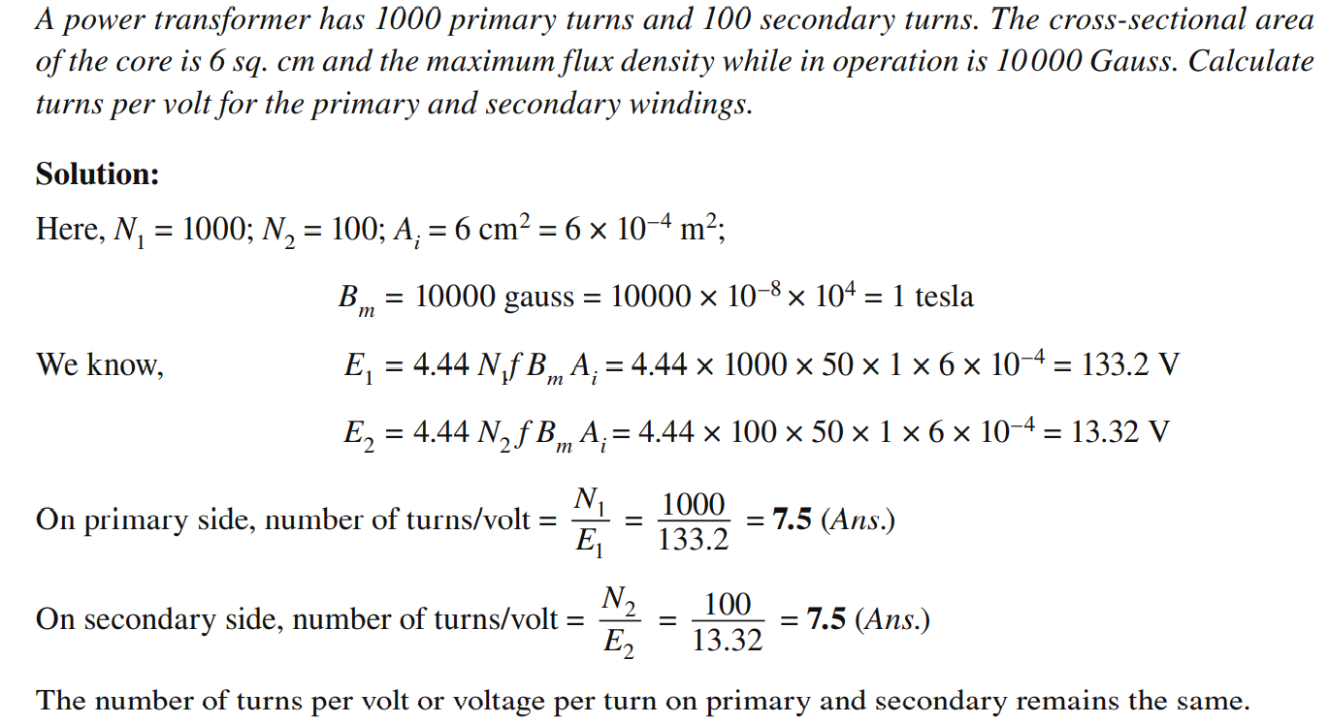
Problem

Slide 49
Induction Motor
Induction machines are also called asynchronous machines.

Slide 50
Induction Motor

Slide 51
Induction Motor

Slide 52
Induction Motor

Slide 53
Induction Motor

Slide 54
Induction Motor

Slide 55
Stepper Motor
A motor in which the rotor turns in discrete movements is called a stepper motor.
A stepper motor, as its name implies, turns in discrete movements called steps.
After the rotor makes a step, it stops turning until it receives the next command (or signal).

Slide 56
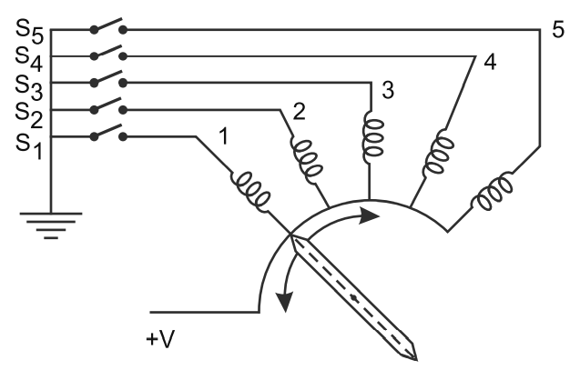
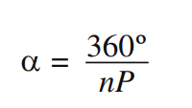

Stepper Motor Operation
Stepper motor operation can be easily visualized by considering a series of electromagnets or solenoids arranged in a circle.
When these solenoids are energized in sequence, their fields interact with the rotor, causing it to turn either clock wise or counter clockwise, depending upon the input commands (or signals).
The stepping angle (α) is determined by the design of the motor, but it should not be greater than 180° in any case.

Slide 57
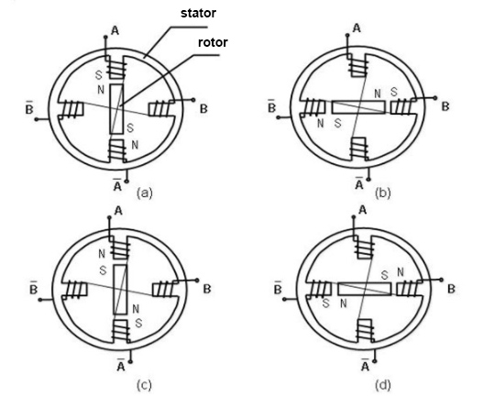
Stepper Motor Operation
The stepper motor rotor is a permanent magnet, when the current flows through the stator winding, produce a vector magnetic field.
The magnetic field drives the rotor to rotate by an angle so that the pair of magnetic fields of the rotor and the magnetic field direction of the stator are consistent.
When the stator's vector magnetic field is rotated by an angle, the rotor also rotates with the magnetic field at an angle.

Slide 58
Stepper Motor Applications
3D printing equipment.
Textile machines.
Printing presses.
Gaming machines.
Medical imaging machinery.
Small robotics.
CNC milling machines.
Welding equipment.

Slide 59
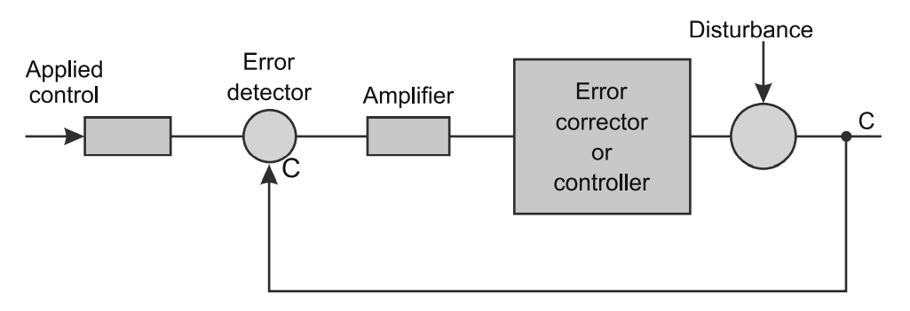
Feedback Control System
A system in which output is compared with the input and error is used to control the operating system is called feedback control system.

Slide 60
Servomechanism
The mechanism in which the control variable is adjusted by the error served, by comparing output and input is called servomechanism.
Any quantity e.g., voltage, speed, temperature, position, direction or torque be controlled by providing appropriate feedback.
When the controlled variable is mechanically positioned or adjusted of its time derivatives, the feedback control system is commonly called a servomechanism.

Slide 61
Servomotor
The motors which respond to the error signal abruptly and accelerate the load quickly are called servomotors. Servomotors are usually employed with control system.
Servomotors may be either DC (shunt or series) motors or AC induction motors. DC motors are preferred because of their high torque to inertia ratio and high starting torque.
On the other hand AC motors are known for their reliability and freedom from commutation problems such as noise and wearing of brushes etc.

Slide 62
Servomotor contd…
The fundamental characteristics in any servomotor (DC or AC) are
The motor output torque should be proportional to its applied control voltage (developed by the amplifier in response to an error signal).
The direction of the toque is determined by the (instantaneous) polarity of the control voltage.

Slide 63
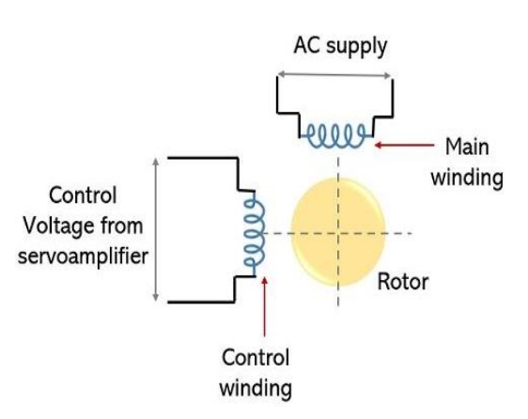
Servomotor contd…
The stator of ac servo motor consists of two separate windings uniformly distributed and separated at 90 °, in space .
Out of the two windings, one is referred as main or fixed winding while the other one is called control winding. A constant ac signal as input is provided to the main winding of the stator.
The control winding is provided with the variable control voltage which is obtained from the servo amplifier.

Slide 64
Servomotor Applications
In robotics to activate movements, giving the arm to its precise angle.
To start, move and stop conveyor belts carrying the product along with many stages. For instance, product labeling, bottling and packaging.
Servo motor is built into the camera to correct a lens of the camera to improve out of focus images.
Solar tracking system to correct the angle of the panel so that each solar panel stays to face the sun.

Slide 65
Servomotor Applications contd…
Metal forming and cutting machines to provide specific motion control for milling machines.
In Textiles to control spinning and weaving machines, knitting machines and looms.
In automatic door openers to control the door in public places like supermarkets, hospitals and theatres.

Slide 66
Brushless DC Motor
Conventional DC motors suffers from two major problems:
They require more maintenance & need to replace brushes periodically.
Their operating voltage and speed is limited because of commutation difficulties.
To over-come these difficulties, eliminate commutator and brushes.
Thus, a motor that retains the characteristics of a DC motor but eliminates the commutator and brushes is called a brushless DC motor.

Slide 67
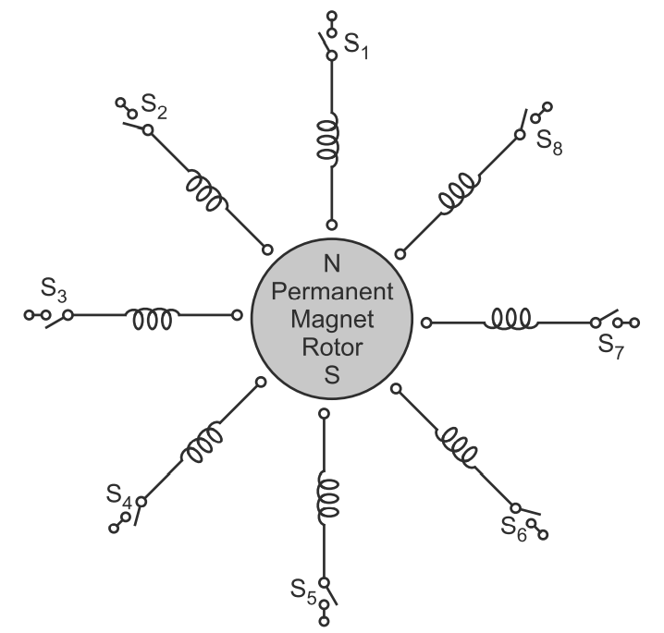
Brushless DC Motor operation
It consists of a multi-phase winding wound on a non-salient stator and a permanent magnet (PM) rotor.
The required voltage is applied to the individual phase winding through a sequential switching operation such that the necessary commutation is achieved to impart rotation to the motor.
The necessary switching operation is achieved by using electronic circuit and devices such as transistors, thyristors, etc.

Slide 68
Brushless DC Motor operation
When switch S1 is closed, winding-1 is energized, the PM rotor is aligned with its magnetic field.
When switch S1 is opened and S2 is closed, winding-2 is energized, the PM rotor is aligned with its magnetic field and turn through a particular angle.
When a number of such phase windings are energized sequentially, the rotor rotates.

Slide 69
Brushless DC Motor
Advantages
Require little or no maintenance
Have longer operating life
Less losses, more operating efficiency
No sparking
Reliable and efficient
Capable to run at very high
Disadvantages
More expensive then conventional DC motors
Additional electronic circuit and devises are required that increases the overall size of the machine

Slide 70
Brushless DC Motor Applications
Due to high reliability and low maintenance these motors find their applications in aerospace industry,
satellites,
gyroscope and
high efficiency robotic system.
These motors are also suitable for artificial heart pumps,
disc drives,
video recorders and
biomedical fields.

